Slide 1
JavaServer Faces,
The Web Tier Alignment & J2EE 5
Jacob Hookom, McKesson
Adam Winer, Oracle

Slide 2
Presentation Goals
Fundamental Ideas Behind JavaServer Faces
A Quick Example
Interoperability and Plug-ability
Component Development
Web Tier Alignment and J2EE 5
Looking Ahead
Airing of Grievances & Feats of Strength

Slide 3
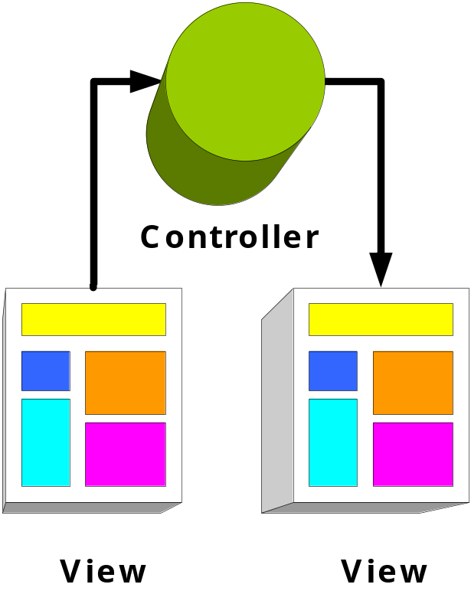
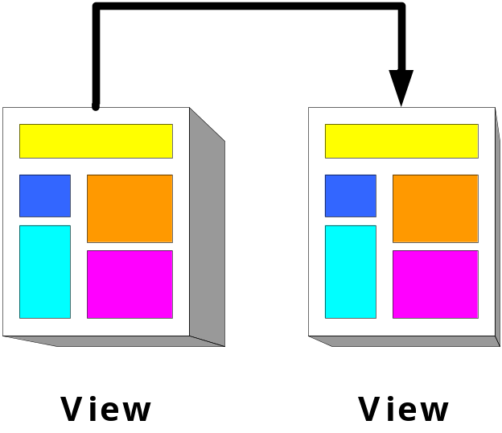
Model/View/Controller 101
Model 1
Model 2

Slide 4
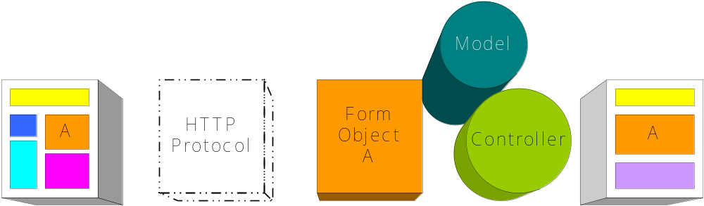
What Does Model 2 Give Me?
Handles More Complex Requirements than Model 1
Single Event Architecture (The Request)
Wraps/Validates Transmitted State
Controller uses Transmitted State to Control Flow
Considered the Best Solution for Years
Notes:
Use Struts as an example and traditional Model and View frameworks
Emphasize pushing data from view to view and how closely tied the two actually are

Slide 5
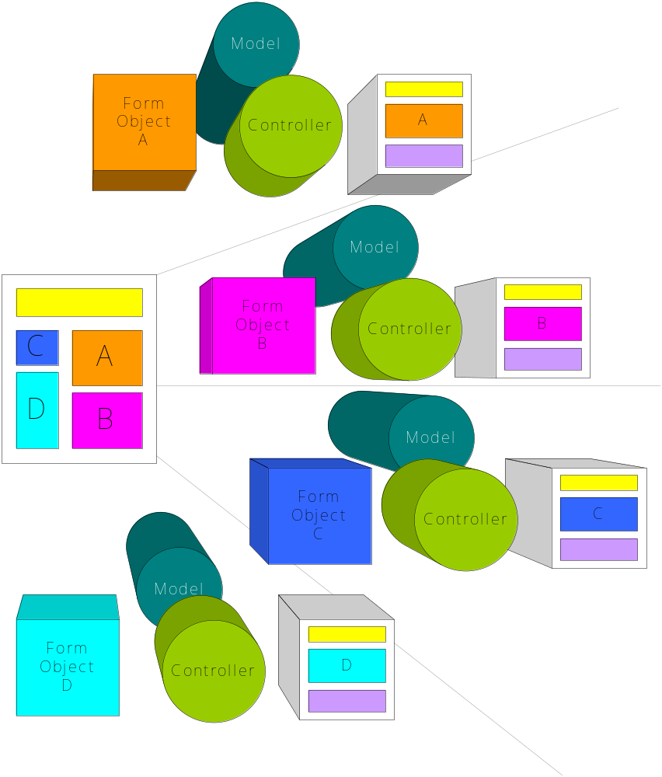
Rich Applications in Traditional MVC
Example
  Display Editable Table
  Manage Validation
  Tree Menu
Routing Events
Managing State
Coordinating Re-Use
Desperate Solutions
Notes:
The goal is to show how complex things get when you try anything beyond simple page->page interaction.

Slide 6
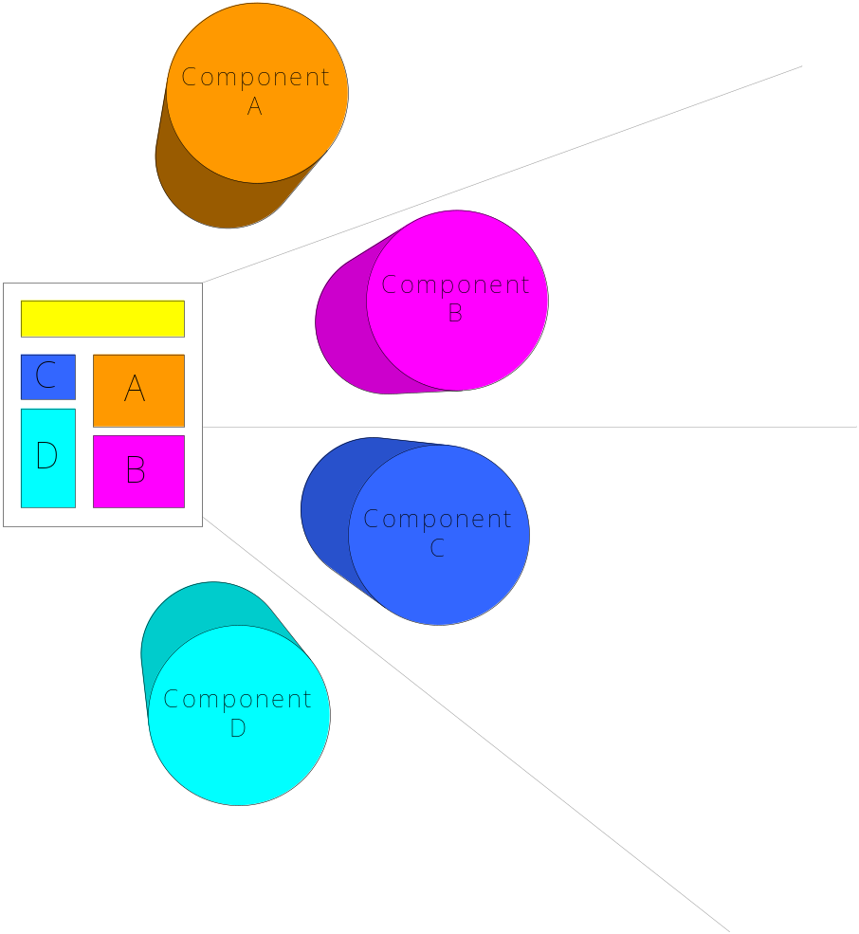
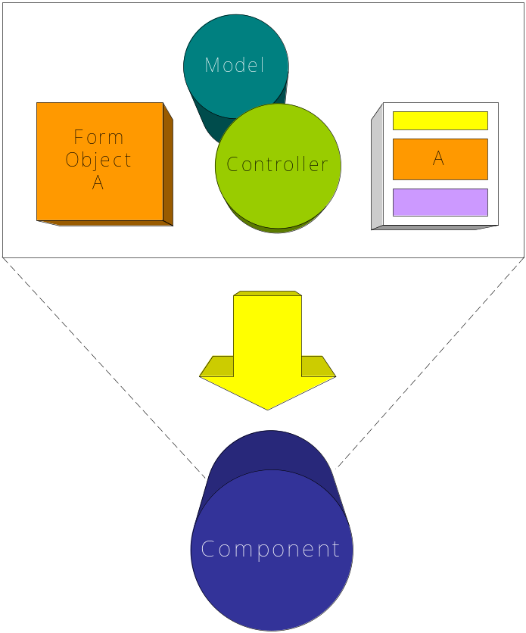
Introducing: The Component
Has State and Behavior
Self Sufficient
Participates in the Full MVC Lifecycle
Are not just for Rendering
Re-usable
Encapsulates Programmer Concerns
Easy to Use

Slide 7
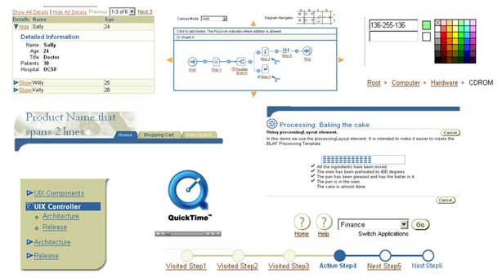
Component Examples

Slide 8
JSF Component Ideas
Integrate with Hibernate for sort able and editable tables with a single tag
Custom layout components as a decorator
Pop-up calendar selection
AJAX-backed tables for managing large amounts of data
Street Map Component
A Client’s ‘Great’ Idea

Slide 9
Discussion Points
What are the goals of MVC frameworks?
Why do we seek solutions like Tiles and Sitemesh?
How can we increase re-use within applications?
Could we be approaching MVC wrong?
What did we get right with Model 1?

Slide 10
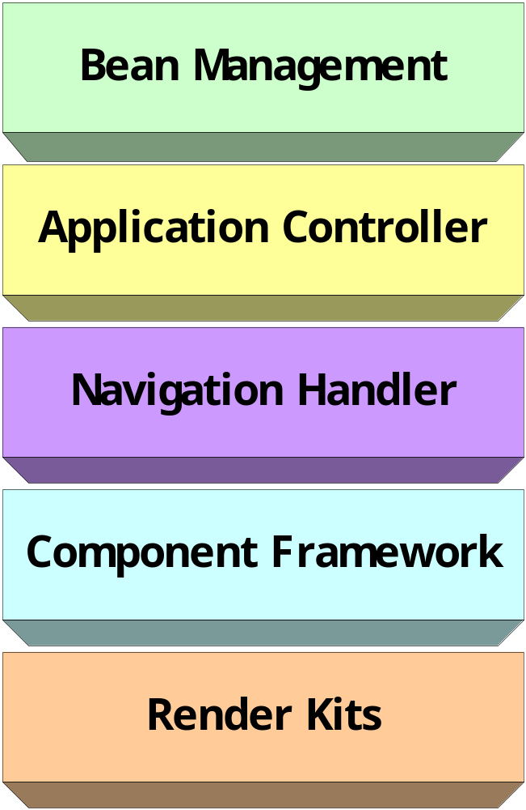
The JavaServer Faces Framework
Built in IoC Container
Integrated EL Support
Scope Management
Simple Controller Framework
Rules Based Navigation
Pluggable Components
Supports Multiple Content Types: XML, XHTML, WAP

Slide 11
An Example: UserBean
public class UserBean {
protected String name;
protected String password;
protected UserDao dao;
public String validate() {
try {
dao.validate(
name, password);
}
catch( Exception e ) {
return “FAIL”;
}
return “PASS”;
}
// get/set ommitted
}
<managed-bean>
<managed-bean-name>
user
</managed-bean-name>
<managed-bean-class>
example.UserBean
</managed-bean-class>
<managed-bean-scope>
session
</managed-bean-scope>
<managed-property>
<property-name>
dao
</property-name>
<value>#{userDao}</value>
</managed-property>
</managed-bean>

Slide 12
An Example: Login Form
<h:form id=“brian”>
<h:inputText value=“#{user.name}” required=“true”/>
<h:inputSecret value=“#{user.password}” required=“true”>
<f:validateLength min=“6”/>
</h:inputSecret>
<h:commandButton action=“#{user.validate}”>
</h:form>
Declare a form around all editable content in the View (JSP)
Both inputText and inputSecret will take care of wiring required state to your model
Pluggable JSF Validators, such as validateLength, offer the same features as Struts Validator
The commandButton will invoke the validate Method on your user bean after property assignment
Notes:
Components, for example, can be expressed via JSP Taglibs

Slide 13
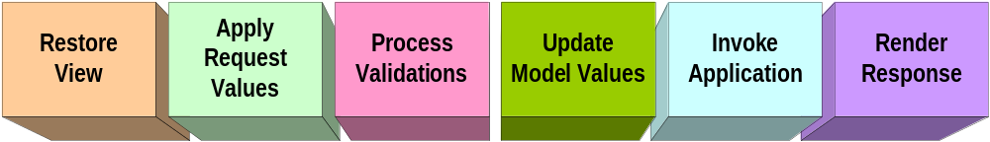
“The Life of Brian”
<h:form id=“brian”>
<h:inputText value=“#{user.login}” required=“true”/>
<h:inputSecret value=“#{user.password}” required=“true”>
<f:validateLength min=“6”/>
</h:inputSecret>
<h:commandButton action=“#{user.validate}”>
</h:form>
Notes:
Walkthrough phases in relation to component tree

Slide 14
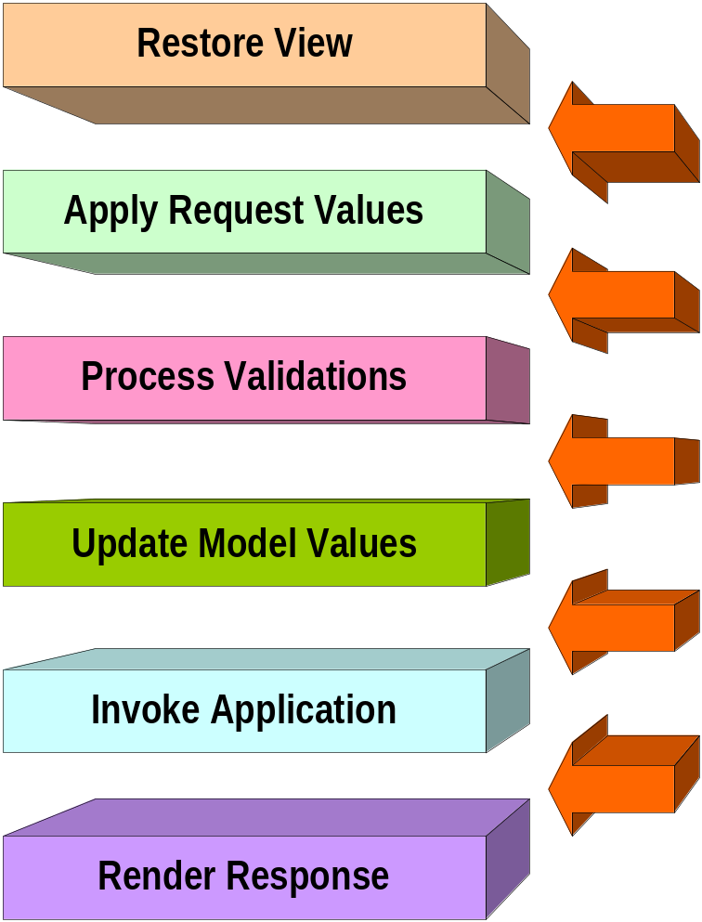
Leveraging Phases and Event Listeners
Any Object/Component can Participate
Think Commons-Chain
Filter-like Capabilities
Use for Managing Security
Model Beans can Receive Events to Setup and Clean up Resources
Components can modify the Lifecycle (e.g. “immediate”).

Slide 15
Integrating Your Models and Behaviors
<h:inputText id=“startDate”
value=“#{bean.startDate}”
converter=“#{utilDate}”
validator=“#{bean.validateStartDate}”
valueChangeListener=“#{controller.listenValue}”
rendered=“#{currentUser.roles[‘manager’]}”
styleClass=“important”/>
<h:commandButton id=“submit”
action=“#{bean.submit}”
actionListener=“#{controller.forward}”
styleClass=“green”/>

Slide 16
Get that Logic Out of the View!
JSF Components follow the same rules as JavaBeans
Components can be pre-defined in your configuration files and jars
Components can reside in any scope
Components can be properties of other Objects
<h:form id=“brian”
binding=“#{registration.steps[1]}”/>
Notes:
Possibly side-line to Tiles/Sitemesh in relation to binding

Slide 17
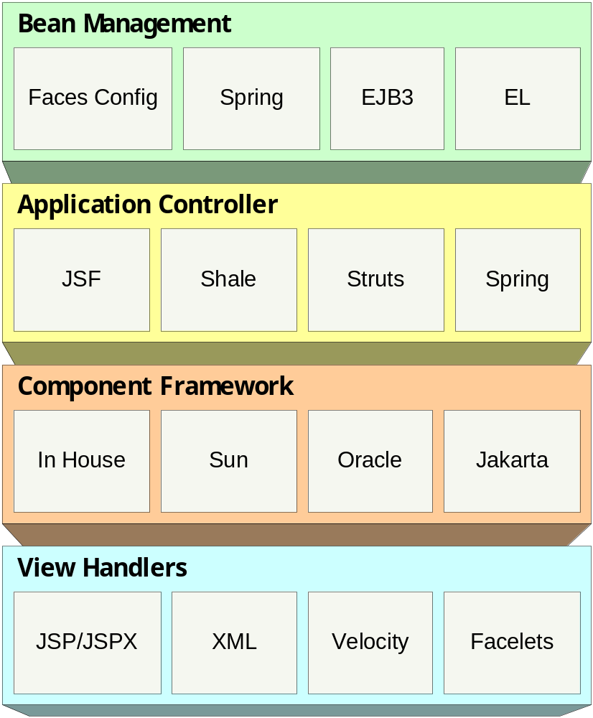
Interoperability and Plug-ability
Who does JSF compete with and what does it replace?

Slide 18
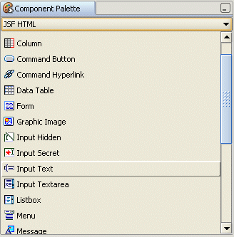
The Role of the Vendor
Visual Tools
  Oracle’s JDeveloper
  Sun’s Studio Creator
  MyEclipse
  IBM WebSphere Studio
Drop-in Components
  Oracle’s ADF Solutions
  ILOG Chart Viewers
  Jakarta MyFaces
  AjaxFaces
  ArcGIS Server Components

Slide 19
JSF Component Development
There are many foundation objects for you to extend behavior/state From
  UIOutput
  UIInput
  UIData
  UICommand
Components can delegate to multiple Renderers
Listener Methods for each Phase in JSF’s Lifecycle (processEncode, processUpdates)
Base JSP Tags to also make Development Easier

Slide 20
Really Simple Component Example
public class HelloComponent
extends UIComponentBase {
protected String name;
public void encodeBegin(
FacesContext ctx) {
ctx.getResponseWriter()
.writeText(“Hello “
+ this.getName()
+ “!”);
}
// get/set omitted
}
<component>
<component-type>
HelloComponent
</component-type>
<component-class>
example.HelloComponent
</component-class>
</component>
After JSP Tag & TLD Development
<my:hello name=“#{param.name}”/>

Slide 21
A Short Demo…
Next is The Web Tier Alignment and J2EE 5

Slide 22
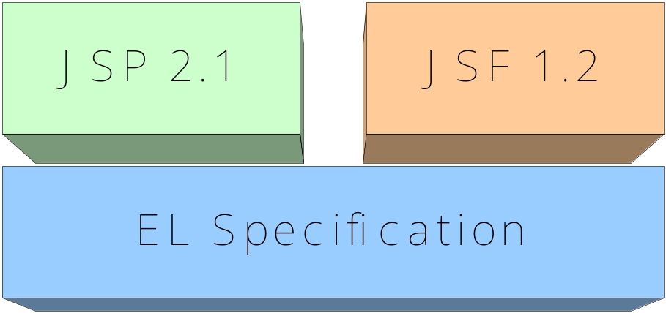
Web Tier Alignment Goals
Unified EL Foundation for both JSP and JSF
Allow JSTL to better serve JSF
Content Interweaving and Tree Creation
Open Development and Specification to the Community
Prepare JSF to be part of J2EE 5

Slide 23
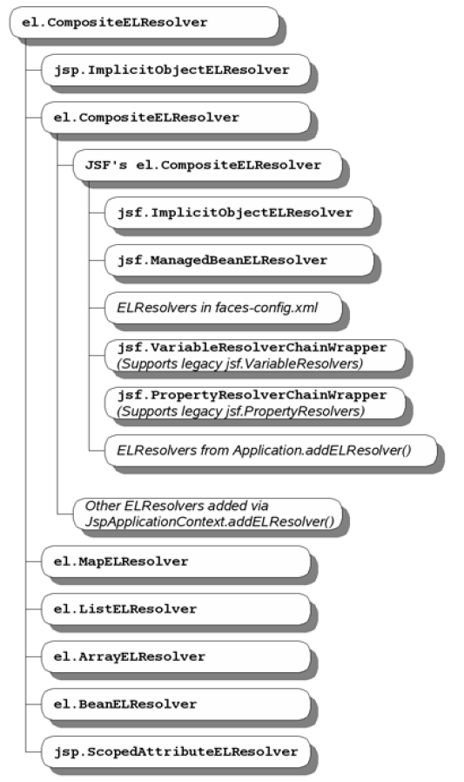
The Unified EL (javax.el)
ExpressionFactory for both #{ } and ${ }
ValueExpressions
MethodExpressions
JSP and JSF Share the concept of an ELContext
New FunctionMapper and VariableMapper Classes
JSP and JSF can plug-in Multiple ELResolvers

Slide 24
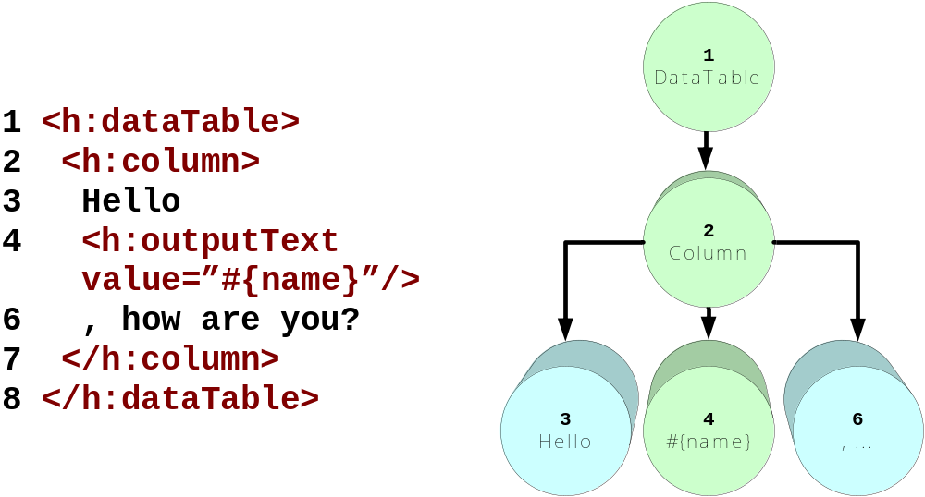
Content Interweaving in Web Tier
“Improving JSF by Dumping JSP”
2 Phase Page Execution
JSTL Use and VariableMapper

Slide 25
JSP Alternative: Facelets
Can Run in JSP 1.2 Containers
Zero Tag Development
Fast Templating and Decorators
Looks like JSPX
Full EL Support
Package Tags within Jars
Tapestry Behaviors (jwcid -> jsfc)

Slide 26
JSF 2.0 and Web Tier Goals
J2SE 5 Annotation Support
  Resource Injection
  Meta-Data
  Validators
More Components in Standard Library
Client Side Scripting
  Validation
  AJAX Support
  Event Decorators
More Complete Meta-Data Support for Tools
Extend EL Language (Enums, Statics)

